Slide 1
CSC 3530: ADVANCED PROGRAMMING
Chapter 10: Web Programming

Slide 2
OBJECTIVES
In this chapter you will learn:
The Common Gateway Interface (CGI) protocol.
The Hypertext Transfer Protocol (HTTP) and HTTP headers.
Web server's functionality.
The Apache HTTP Server.
To request documents from a Web server.
To implement CGI scripts.
To send input to CGI scripts using XHTML forms.

Slide 3
TOPIC
10.1 Introduction
10.2 HTTP Request Types
10.3 Multitier Architecture
10.4 Accessing Web Servers
10.5 Apache HTTP Server
10.6 Requesting XHTML Documents
10.7 Introduction to CGI
10.8 Simple HTTP Transactions
10.9 Simple CGI Scripts
10.10 Sending Input to a CGI Script
10.11 Using XHTML Forms to Send Input

Slide 4
10.1 Introduction
Web servers
Respond to client requests by providing resources
User requests by entering a uniform resource locator (URL)
Server returns the requested document
Communication is performed through Hypertext Transfer Protocol (HTTP)
Protocol for transferring requests and files
Platform-independent

Slide 5
10.2 HTTP Request Types
Request types (a.k.a. request methods)
Specify how a client sends requests to a server
Often processed by a server-side form-handler program
Most common request types are get and post
Retrieve and send client form data from and to web server
Contain information entered from graphical-user-interface components
get request
Retrieve information (e.g., a document or an image)
Sends form data as query string in the URL

Slide 6
10.2 HTTP Request Types (Cont.)
Request types (Cont.)
post request
Sends data to the server
Often used for posting messages, authentication, etc.
Browser caching
Browsers often save Web pages on disk for quick reloading
Mostly used for get requests
Are typically static
Not used for post requests
Contents may change frequently

Slide 7
Fig. 19.1 | HTTP’s other request types.

Slide 8
10.3 Multitier Architecture
A multitier application
Divides functionality into separate tiers
A Web server is an example
Bottom tier
Also called information tier or data tier
Maintains data for the application
Typically stored in a relational database management system (RDBMS)

Slide 9
10.3 Multitier Architecture (Cont.)
A multitier application (Cont.)
Middle tier
Also called business logic tier
Implements business logic
Controls interactions between clients and data
Enforces business rules
Ensures data is reliable
Dictates how clients can access data

Slide 10
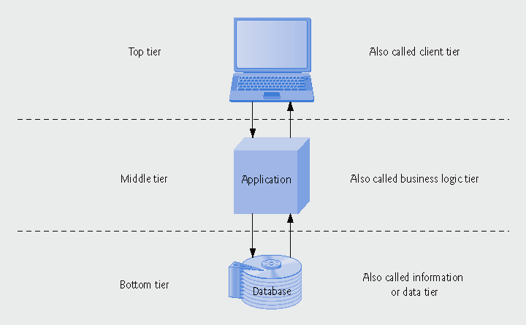
Fig. 19.2 | Three-tier application model.

Slide 11
10.3 Multitier Architecture (Cont.)
A multitier application (Cont.)
Top tier
Also called client tier
Is the user interface
Makes requests with lower tiers
Displays retrieved data to the user

Slide 12
10.4 Accessing Web Servers
Web servers
Local Web servers
Reside on users’ machines
Remote Web servers
Reside on machines across a network
Host
Computer that stores and maintains resources
localhost
Host name that references local machine

Slide 13
10.4 Accessing Web Servers (Cont.)
Domain
Represents a group of hosts on the Internet
Each domain has a domain name or Web address
Fully qualified domain name (FQDN)
Also known as the machine name
Contains
A host name
A domain name, including
A top-level domain (TLD)
Often describes type of organization owning the domain

Slide 14
10.4 Accessing Web Servers (Cont.)
Fully qualified domain name (Cont.)
Example
www.deitel.com
Host name is www
Top-level domain is com
Usually refers to a commercial business

Slide 15
10.4 Accessing Web Servers (Cont.)
IP (Internet Protocol) address
Used to locate other computers on the Internet
Each FQDN corresponds to an IP address
Comprised of four sets of numbers separated by periods
Such as 63.110.43.82
The loopback address
IP address of localhost is always 127.0.0.1

Slide 16
10.4 Accessing Web Servers (Cont.)
Domain Name System (DNS) server
Computer that maintains a database of FQDNs and corresponding IP addresses
DNS lookup
Translating FQDNs to IP addresses
Example
(FQDN) www.deitel.com translates to (IP address) 63.110.43.82

Slide 17
10.5 Apache HTTP Server
The Apache HTTP server
Maintained by the Apache Software Foundation
Most popular Web server because of its:
Stability
Cost
Efficiency
Portability
Is open-source (source code is freely available)

Slide 18
10.5 Apache HTTP Server (Cont.)
The Apache HTTP server (Cont.)
Runs on platforms:
UNIX
Linux
Windows
To download/install the Apache HTTP server
httpd.apache.org/

Slide 19
10.6 Requesting XHTML Documents
XHTML documents in the Apache HTTP server
Must be saved in the htdocs directory
On Windows platforms, htdocs is in C:\Program Files\Apache Group\Apache2
On Linux platforms, htdocs is in /usr/local/httpd
Root directory of the Web server refers to default directory htdocs
Do not have to enter htdocs before a file name in a URL

Slide 20
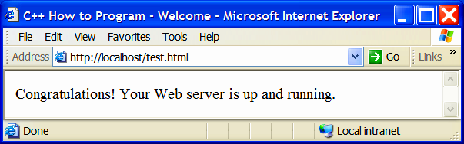
Fig. 19.3 | Requesting test.html from Apache.

Slide 21
10.7 Common Gateway Interface
Common Gateway Interface (CGI)
Standard protocol for enabling applications to interact with Web servers and clients
Applications are called CGI programs or CGI scripts
Often used to generate dynamic Web content
Generated programmatically when page is requested
Not specific to any operating system or programming language
Developed in 1993 by NCSA (National Center for Supercomputing Applications)
For use with its HTTPd Web server

Slide 22
10.8 Simple HTTP Transactions
An XHTML document
Plain text file that contains markings (markup or elements)
Markings describe structure of data
Example
<title>My Web Page</title>
<title> start tag
My Web Page is the title of the Web page
</title> end tag
Also can contain hypertext information (hyperlinks)
Links to other Web pages or other locations

Slide 23
10.8 Simple HTTP Transactions (Cont.)
A Web XHTML file’s URL
Example
http://www.deitel.com/books/downloads.html
Protocol of the resource is http
Machine name is www.deitel.com
Name of the requested resource is /books/downloads.html
Resource name is downloads.html
Path is /books
A virtual directory
Alias or fake name for physical directory on disk
Server translates virtual path into real location

Slide 24
10.8 Simple HTTP Transactions (Cont.)
An HTTP transaction
GET /books/downloads.html HTTP/1.1 Host: www.deitel.com
GET indicates a get request
Name and path of resource
Protocol’s name and version number

Slide 25
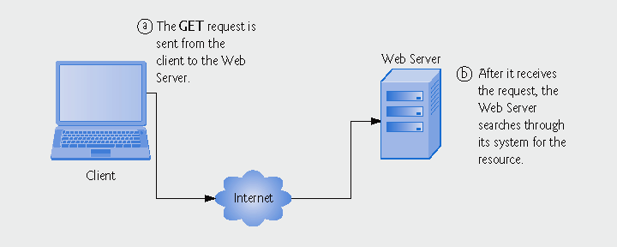
Fig. 19.4 | Client interacting with server and Web server. Step 1: The get request, GET /books/downloads.html HTTP/1.1. (Part 1 of 2.)

Slide 26
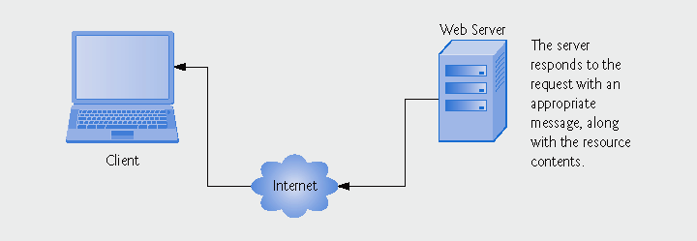
Fig. 19.4 | Client interacting with server and Web server. Step 2: The HTTP response, HTTP/1.1 200 OK. (Part 2 of 2.)

Slide 27
10.8 Simple HTTP Transactions (Cont.)
An HTTP transaction (Cont.)
Server’s response
Indicates the HTTP version
Followed by numeric code and phrase for the status
HTTP/1.1 200 OK
Indicates success
HTTP/1.1 404 Not found
Indicates resource was not found
Then sends HTTP headers
Provides information about the data being sent
Example
Content-Type: text/html

Slide 28
10.8 Simple HTTP Transactions (Cont.)
An HTTP transaction (Cont.)
Server sends blank line to indicate headers are finished
Server finally sends contents of requested document
MIME (Multipurpose Internet Mail Extensions)
Identified in the Content-Type header
Helps browser determine how to process data
Examples
text/plain
Data contains text, without XHTML markup
image/gif
Content is a GIF image

Slide 29
10.9 Simple CGI Scripts
CGI Scripts
Executing a C++ program as a CGI script
Place compiled C++ executable file in Web server’s cgi-bin directory
Executable file extension .exe may be changed to .cgi
Standard output is redirected (piped) to Web server
Web server sends output to Web browser
Detected by Web server depending on server configuration
Special filename extension (.cgi or .exe)
Located in a specific directory (cgi-bin)
Web server automatically adds HTTP-transaction-status message

Slide 30
Outline
localtime.cpp
(1 of 2)
Declare time_t variable currentTime
CGI script must output the Content-Type header and the subsequent blank line
Get the current time and store it in currentTime

Slide 31
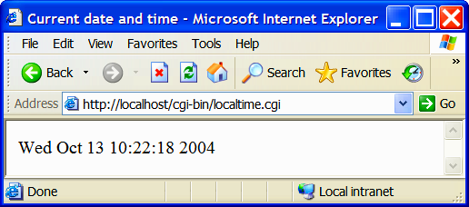
Outline
localtime.cpp
(2 of 2)
Output a string containing the “broken-down” version of the local time

Slide 32
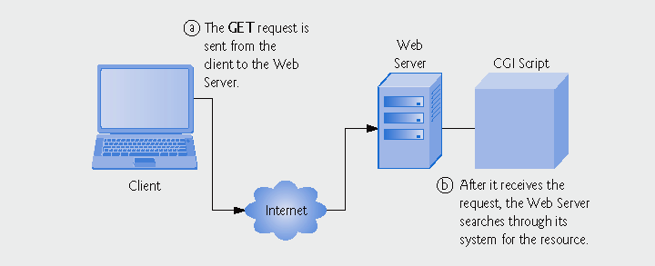
Fig. 19.6 | Step 1: The get request, GET /cgi-bin/localtime.cgi HTTP/1.1. (Part 1 of 4.)

Slide 33
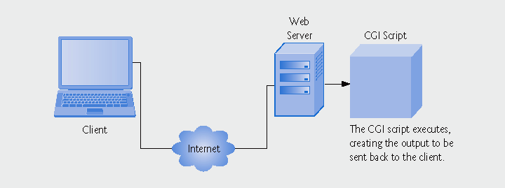
Fig. 19.6 | Step 2: The Web server starts the CGI script. (Part 2 of 4.)

Slide 34
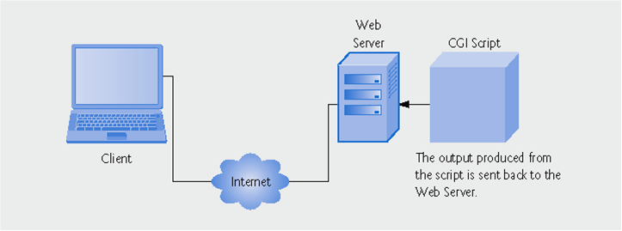
Fig. 19.6 | Step 3: The script output is sent to the Web server. (Part 3 of 4.)

Slide 35
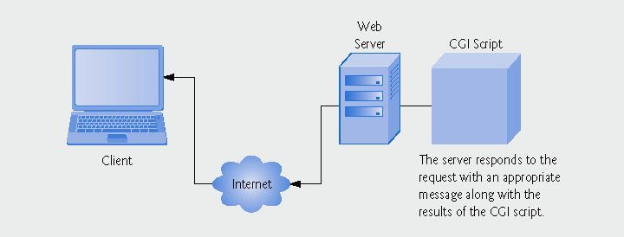
Fig. 19.6 | Step 4: The HTTP response, HTTP/1.1 200 OK. (Part 4 of 4.)

Slide 36
Common Programming Error 10.1
Forgetting to place a blank line after a header is a syntax error.

Slide 37
Fig. 19.7 | Output of localtime.cgi when executed from the command line.

Slide 38
10.9 Simple CGI Scripts (Cont.)
Environment variables
Contain information about client and server environment
Such as type of Web browser or location of document
Are server-specific
Retrieved by calling function getenv of <cstdlib>
Takes a char * string naming the environment variable
Returns associated value of the environment variable as a char * string
Returns null pointer if the environment variable does not exist

Slide 39
Outline
environment.cpp
(1 of 4)
Initialize an array of string objects with the names of the CGI environment variables

Slide 40
Outline
environment.cpp
(2 of 4)
Output the name of the environment variable in an XHTML table-data element
Attempt to retrieve the value associated with the environment variable
Output the environment-variable value returned by getenv

Slide 41
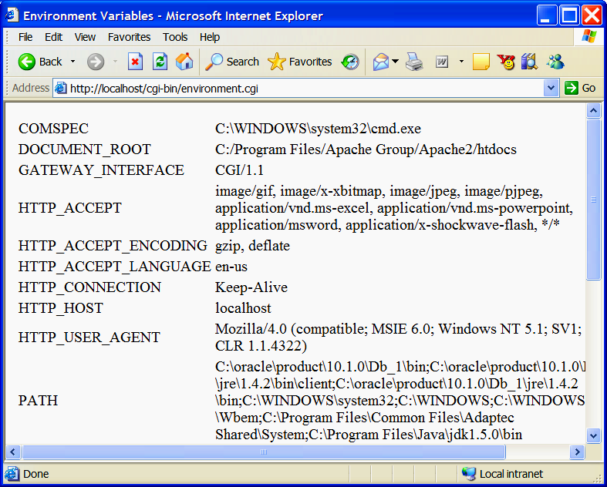
Outline
environment.cpp
(3 of 4)

Slide 42
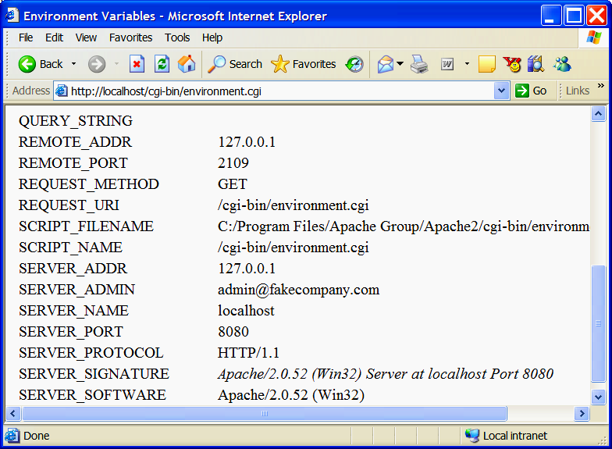
Outline
environment.cpp
(4 of 4)

Slide 43
10.10 Sending Input to a CGI Script
Environment variable QUERY_STRING
Contains information that is appended to a URL in a get request
Example
www.site.com/cgi-bin/script.cgi?state=Cali
Requests CGI script cgi-bin/script.cgi
With query string state=Cali
The query string following the ? delimiter is stored in environment variable QUERY_STRING

Slide 44
Outline
querystring.cpp
(1 of 3)
Pass "QUERY_STRING" to function getenv
Assign the returned query string to string variable query

Slide 45
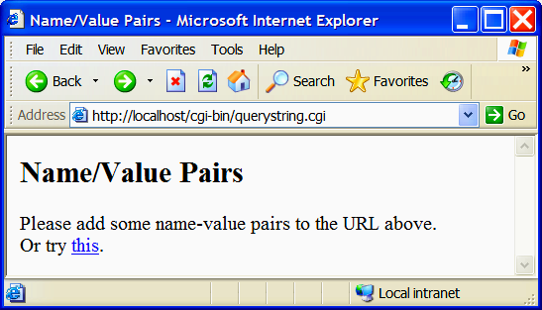
Test if query contains data
Outline
querystring.cpp
(2 of 3)
Output the contents of the query string

Slide 46
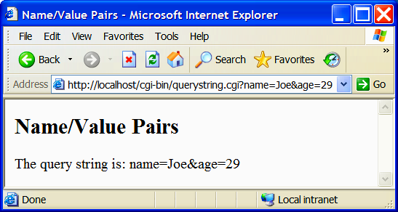
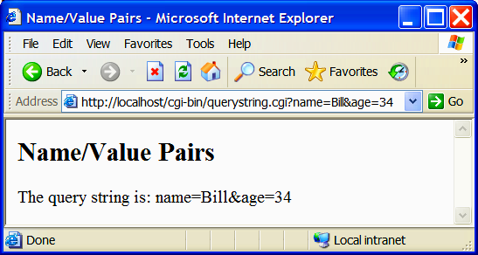
Outline
querystring.cpp
(3 of 3)

Slide 47
10.11 Using XHTML Forms to Send Input
XHTML form element
Encloses an XHTML form
Generally takes two attributes
action specifies server resource to execute when user submits the form
method identifies type of HTTP request to use when submitting the form
May contain any number of internal elements
Using XHTML form with get
Names of input fields and user-inputted values are passed as a query string
Ampersand-separated list of pairs, each with = between the name and the value

Slide 48
Fig. 19.10 | XHTML form elements. (Part 1 of 2)

Slide 49
Fig. 19.10 | XHTML form elements. (Part 2 of 2)

Slide 50
Outline
getquery.cpp
(1 of 4)

Slide 51
Attribute method has the value "get"
Outline
Attribute action has the value "getquery.cgi"
getquery.cpp
(2 of 4)
Single-line text field named word
A button, labeled Submit Word, to submit the form data
Search query for the first occurrence of word= and add 5
Take the substring in query containing the user’s favorite word
Output the word entered by the user

Slide 52
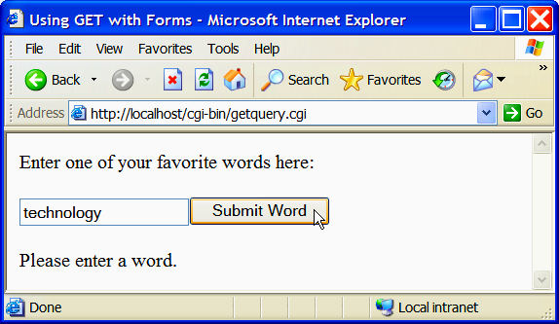
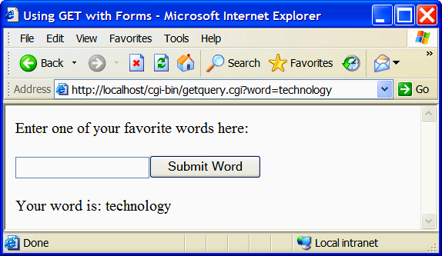
Outline
getquery.cpp
(3 of 4)
Query string is appended to the URL with a question mark (?) in front of it

Slide 53
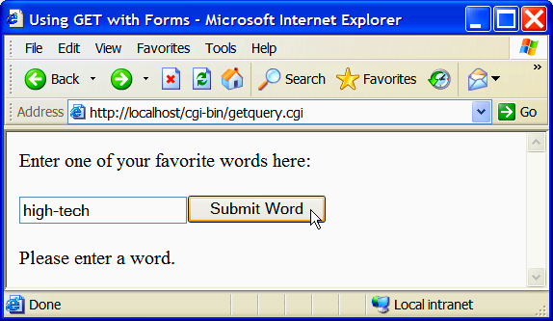
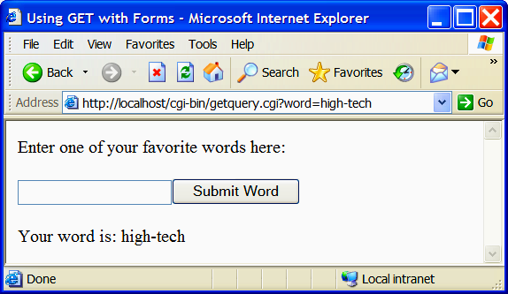
Outline
getquery.cpp
(4 of 4)

Slide 54
10.11 Using XHTML Forms to Send Input (Cont.)
Using XHTML form with post
Data is sent to CGI script via standard input
Data is encoded the same as with the get method
Name-value pairs with equals signs and ampersands
CONTENT_LENGTH environment variable set to indicate number of characters sent
Use cin.read instead of stream extraction on cin
CGI specification does not require a newline to be appended to the end of the form data
Stream extraction operation may not terminate if no newline is there

Slide 55
Outline
post.cpp
(1 of 5)
Determine whether CONTENT_LENGTH contains a value
Read in the value of CONTENT_LENGTH and convert it to an integer
Use function cin.read to read form data from standard input

Slide 56
Outline
post.cpp
(2 of 5)
Check if any form data was sent

Slide 57
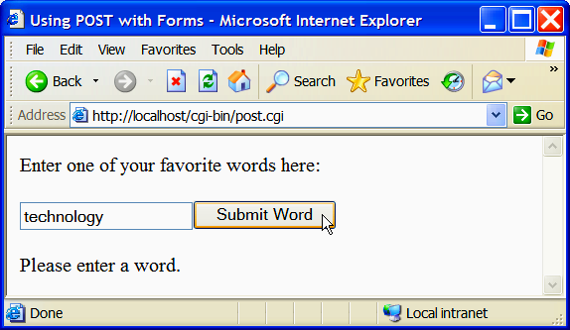
Outline
post.cpp
(3 of 5)

Slide 58
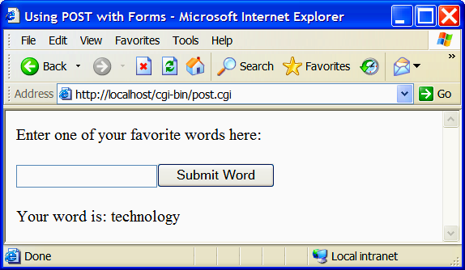

Outline
post.cpp
(4 of 5)

Slide 59
Outline
post.cpp
(5 of 5)

Slide 60
10.11 Using XHTML Forms to Send Input (Cont.)
URL encoding
Web browsers “URL encode” the XHTML form data they send
Spaces are replaced with plus signs
Other symbols are translated into hexadecimal ASCII values preceded with %
Because URLs cannot contain certain characters

